Slide 1
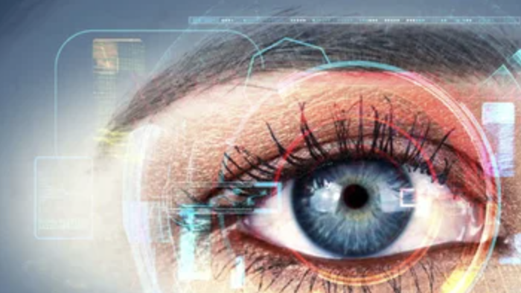
What our eyes can tell us
Google’s AI can see through our eyes what our doctors can’t

Slide 2
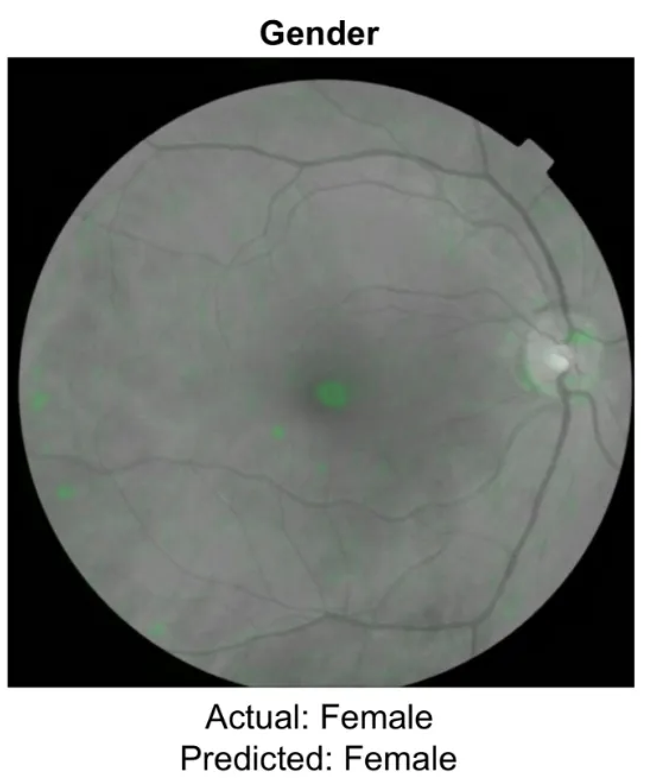
What do you see?

Slide 3
This AI connected patterns to distinguish gender AaB, with an AUC of 0.97
Detects more True positives and negatives

Slide 4
How does it work?
Convolutional neural network, optimised for image classification.
Deep Learning (ML) for training.
Diseased vs healthy eye comparison
Model “looks” at generally random areas of the eye.
Attention maps (saliency or heat maps) were generated to represent what it was looking at, and 100 random samples were presented to ophthalmologists.
It was looking at a bit of everything, but nothing specifically at all.

Slide 5
Comes from major model collab with US and India experts & hospitals, with initial purpose of aiding Diabetic Retinopathy diagnosis.
Ophthalmologists review and prediction from the algorithm for debate and decision on final diagnosis.
July 2018 results
Training dataset of 128K images
2 validation sets:
a random sample of almost 10K images
and a public dataset of 1.7K images
The model worked insanely well!
96–97% sensitivity and 93% specificity, helping them get as few false negatives as they could.

Slide 6
What’s the use of this?
Nothing, right now.

Slide 7
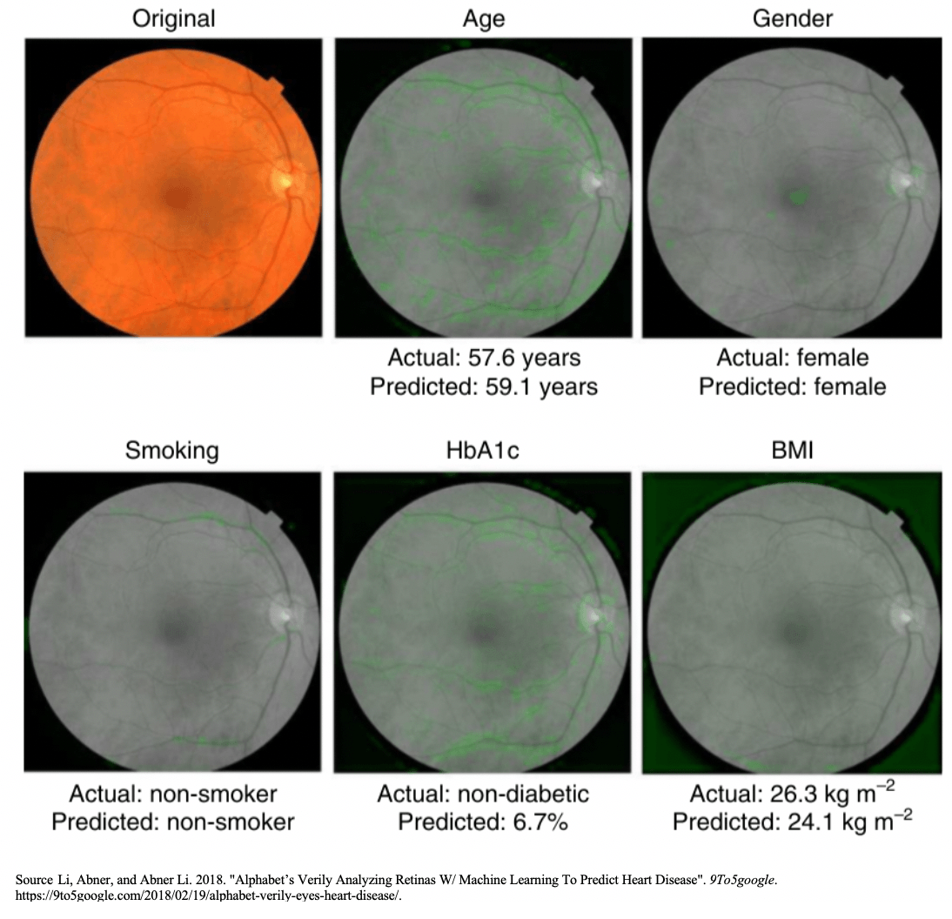
Opens doors for anatomy research
More personalised and efficient approach to diagnosis

Slide 8
Thank you

